Slide 1
Group 2 ETL Presentation
Abhinanditha Thamada, Alekhya Jilla, Sai Srilekha Aluru, Venkat Ramana Sangam, Yasaswi Pasam.

Slide 2
Introduction
FHIR (Fast Healthcare Interoperability Resources) is a revolutionary standard developed by HL7 (Health Level Seven International) that aims to simplify healthcare data exchange and improve interoperability between different healthcare systems
A FHIR-based API is a tool that enables healthcare applications to securely access and share electronic health records (EHRs) using the FHIR standard. These APIs offer a consistent and reliable way for healthcare providers to exchange patient information across different systems.
Developers can leverage FHIR-based APIs to create applications that gather and utilize patient data from various sources in a standardized and interoperable way.

Slide 3
Standardized Data Exchange: FHIR offers a contemporary, web-based method for connecting healthcare applications through standardized resources. Unlike older healthcare data exchange standards, FHIR uses a more user-friendly, web-oriented format based on developer-friendly tools such as RESTful APIs, JSON, and XML.
Security: FHIR prioritizes the protection of healthcare data by offering robust security measures that safeguard patient information from unauthorized access, tampering, and cyber threats, while ensuring privacy and enabling secure, efficient data exchange across healthcare systems.

Slide 4
Purpose
Our ETL pipeline aims to streamline the process of accessing patient and clinical data, enriching it with terminology services, and ensuring seamless integration into target systems. By leveraging FHIR APIs, the project demonstrates how healthcare data can be standardized and shared across systems to enhance clinical workflows and healthcare interoperability.

Slide 5
Link to the Project Repository
https://github.iu.edu/ajilla/group_2_project?tab=readme-ov-file

Slide 6
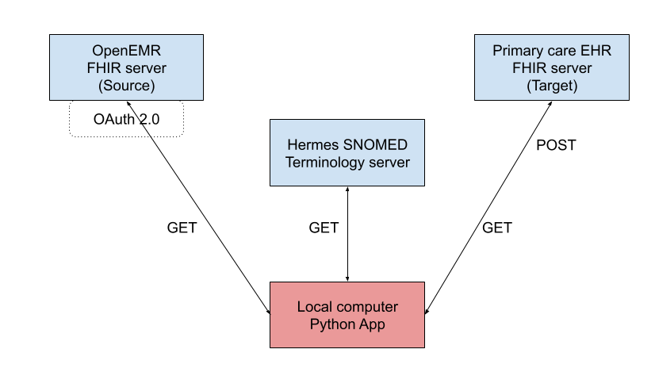
ETL Pipeline Overview

Slide 7

CODING TASK 1

Slide 8
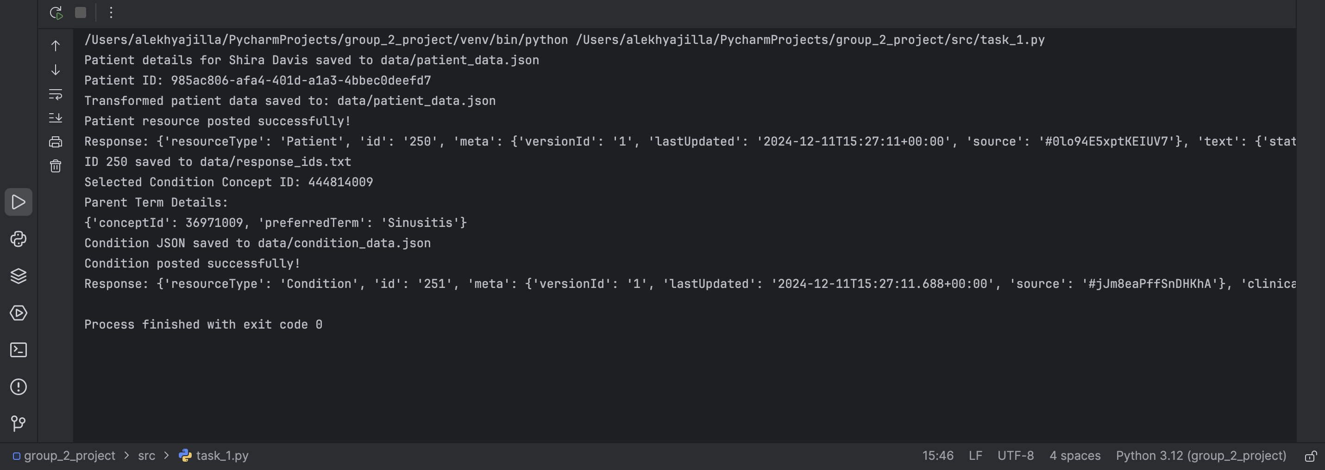
LIVE DEMONSTRATION OF THE CODE FOR THIS OUTPUT

Slide 9
Coding Task 1: Extract
Patient Data Retrieval: Patient details were extracted from the OpenEMR FHIR server using the first and last names. The FHIR API endpoint was queried, and the corresponding resource ID was retrieved.
Condition Data Retrieval: The associated conditions were fetched using the patient's resource ID. The Condition resource's code field provided the concept ID of a selected condition.
Parent Term Retrieval: The concept ID was used to query the Hermes terminology server through Expression Constraint Language (ECL) to obtain the parent term and its concept ID.

Slide 10
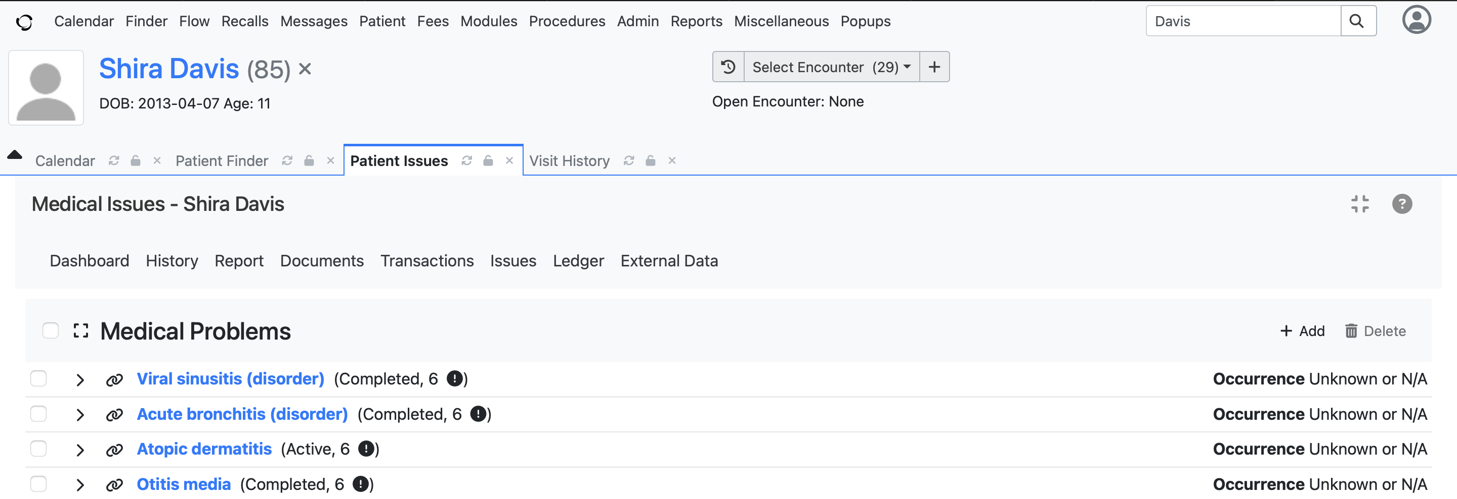
Medical Problems of ‘Shira Davis’ as seen in OpenEMR

Slide 11
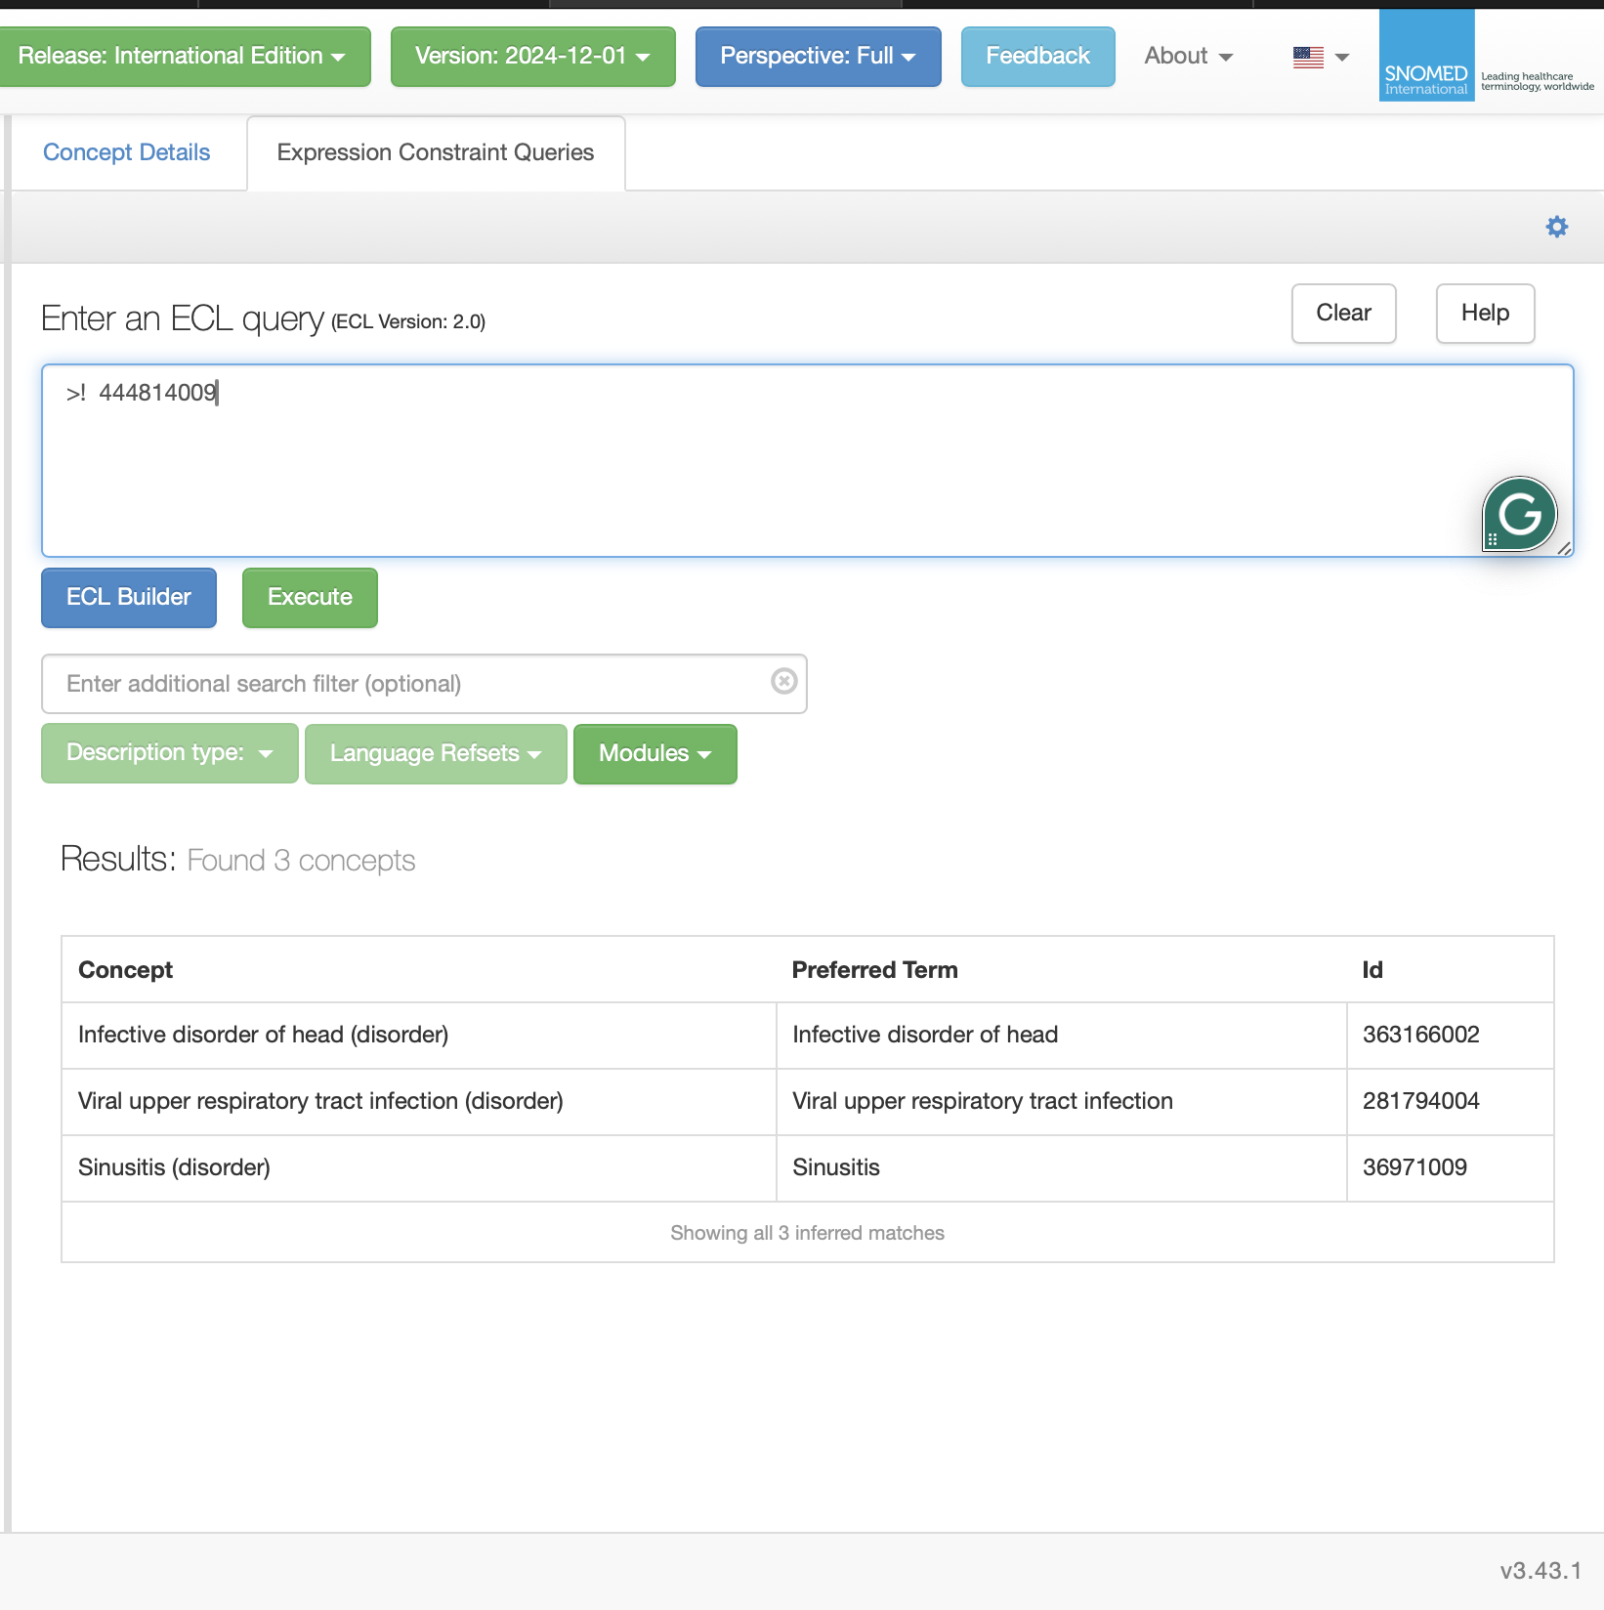
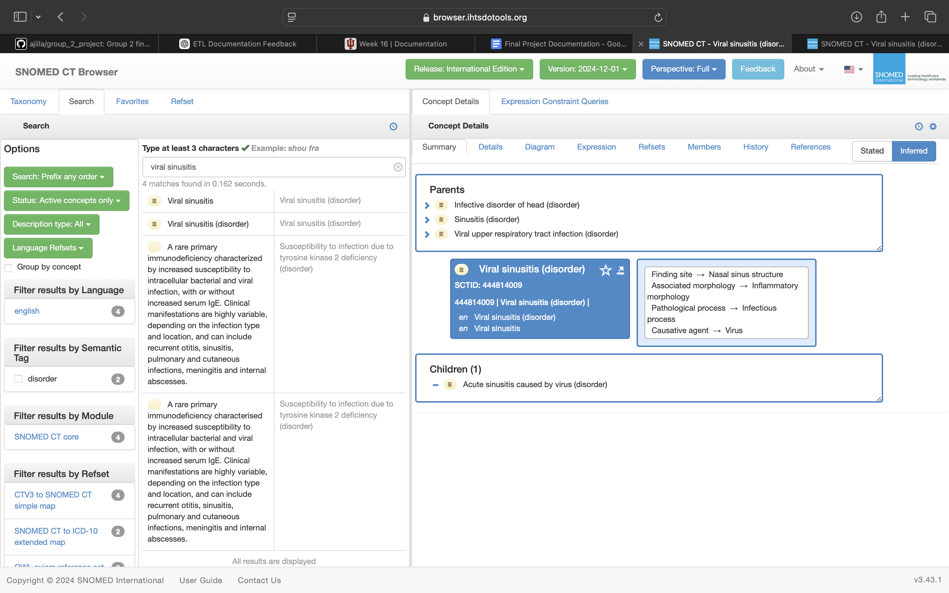
Selected Condition and ECL to fetch Parent Term

Slide 12
Coding Task 1: Transform
Patient Resource:
The address fields (line, city, state, postal code) were merged into a single formatted field.
A unique patient ID was dynamically generated using Python's random. randint function.
The current date and time were generated for resource validation using the datetime module.
Condition Resource:
The fetched parent term and its concept ID were incorporated into the Condition resource.
The patient resource ID was linked to the Condition resource to maintain patient.

Slide 13
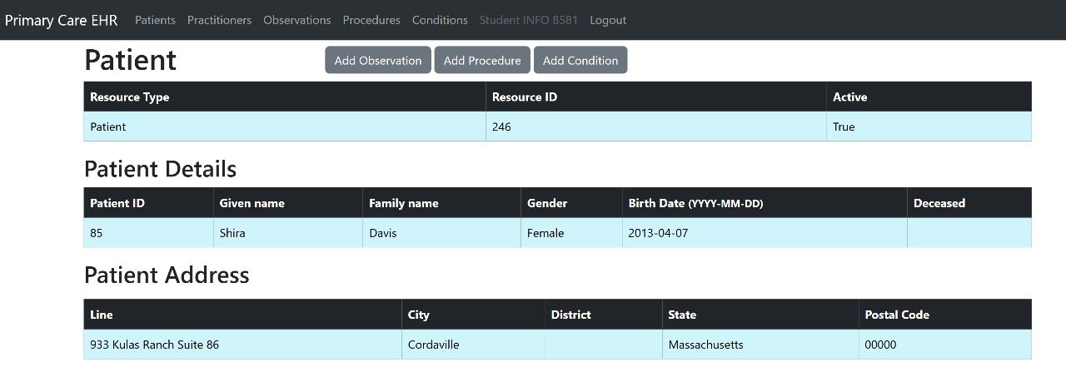
Patient Resource in Target API Server Without Transformations

Slide 14
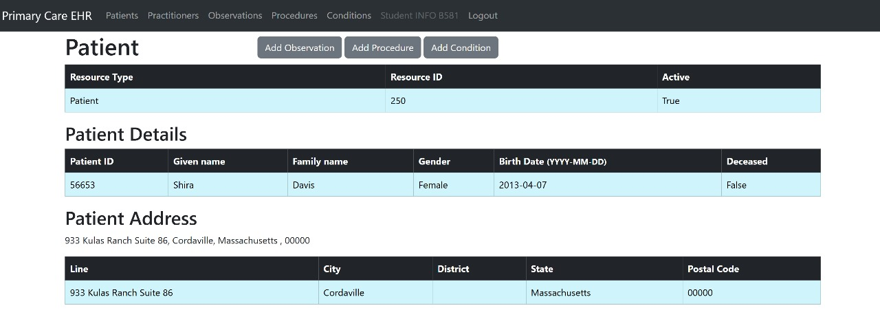
Patient Resource in Target API Server With Transformations

Slide 15
Coding Task 1: Load
Patient Resource Creation: The transformed Patient JSON was posted to the Primary Care EHR server, and the response (containing the newly created patient ID) was saved in response_ids.txt for future reference.
Condition Resource Creation: A new Condition JSON of the parent term is linked to the created patient and was posted to the Primary Care EHR server. The association between the patient and condition ensured proper linkage of healthcare data.

Slide 16
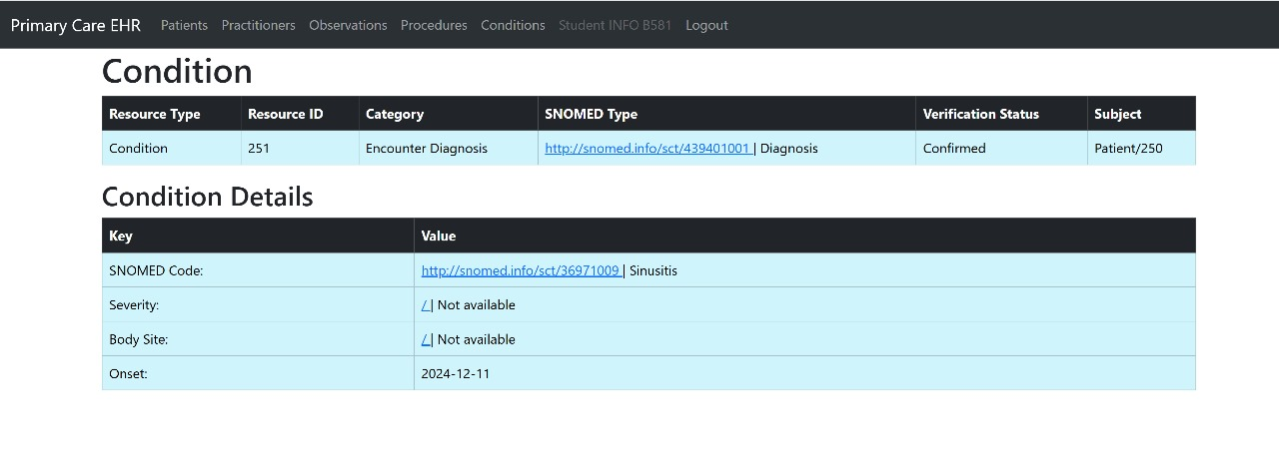
Condition Resource in Target API Server Linked with Patient

Slide 17
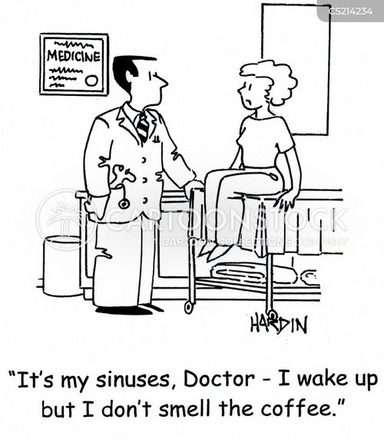
CODING TASK 2

Slide 18
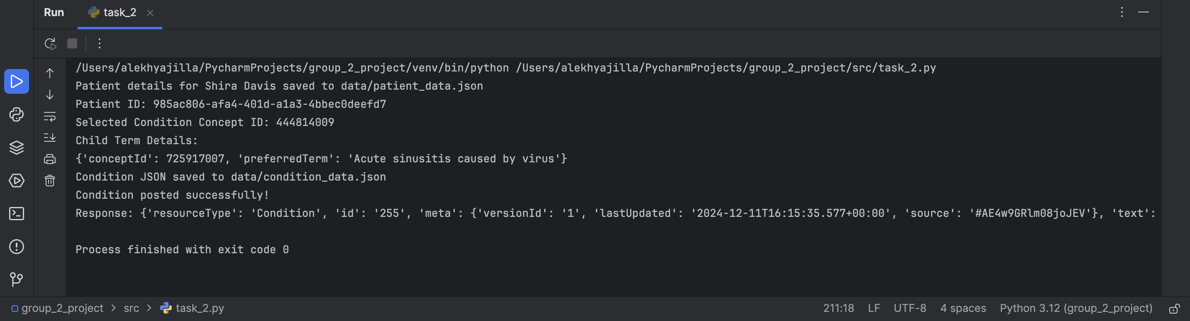
LIVE DEMONSTRATION OF THE CODE FOR THIS OUTPUT

Slide 19
Coding Task 2 : Extract
Patient Data Retrieval: Patient details, including their resource ID, were extracted from the OpenEMR FHIR server using the same first and last names used in Coding Task 1.
Condition Data Retrieval: Using the patient’s resource ID, the associated Condition resources were fetched. A specific condition was selected, and its concept ID was identified from the code field.
Child Term Retrieval: The concept ID was used to query the Hermes terminology server via Expression Constraint Language (ECL) to obtain the child term and its concept ID.

Slide 20
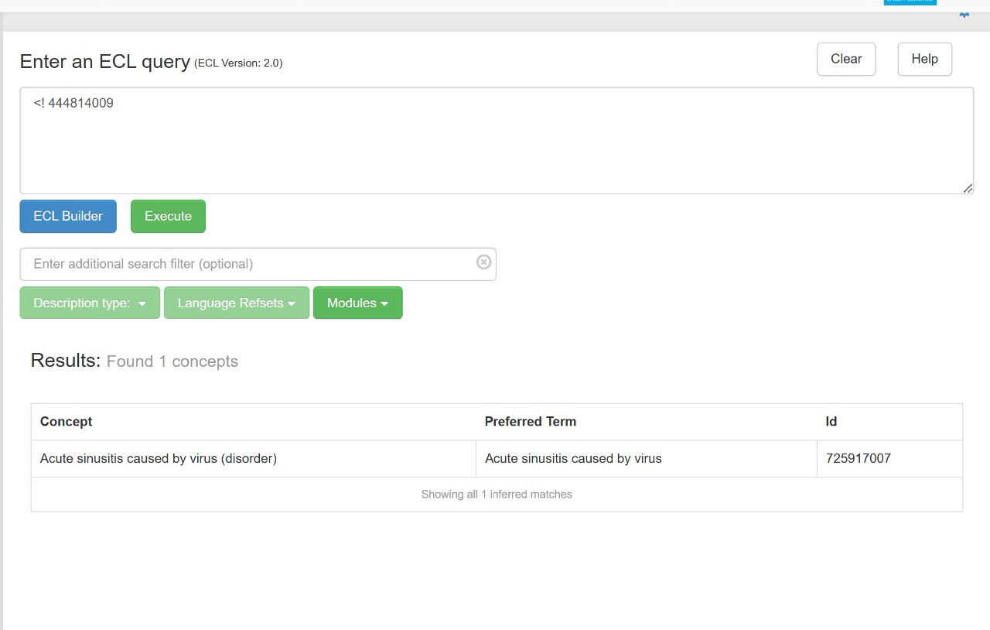
Selected Condition and ECL to fetch Child Term

Slide 21
Coding Task 2 : Transform
Condition Resource:
The extracted child term and its concept ID were incorporated into a new Condition resource JSON.
The patient resource ID, retrieved from response_ids.txt, was linked to the newly created Condition resource to maintain consistent data relationships.
The resource was formatted to comply with the FHIR structure required by the Primary Care EHR server.

Slide 22
Coding Task 2: Load
Condition Resource Creation:
The transformed Condition JSON was posted to the Primary Care EHR server.
The Condition was successfully linked to the patient created in Coding Task 1 using the saved patient ID from response_ids.txt.

Slide 23
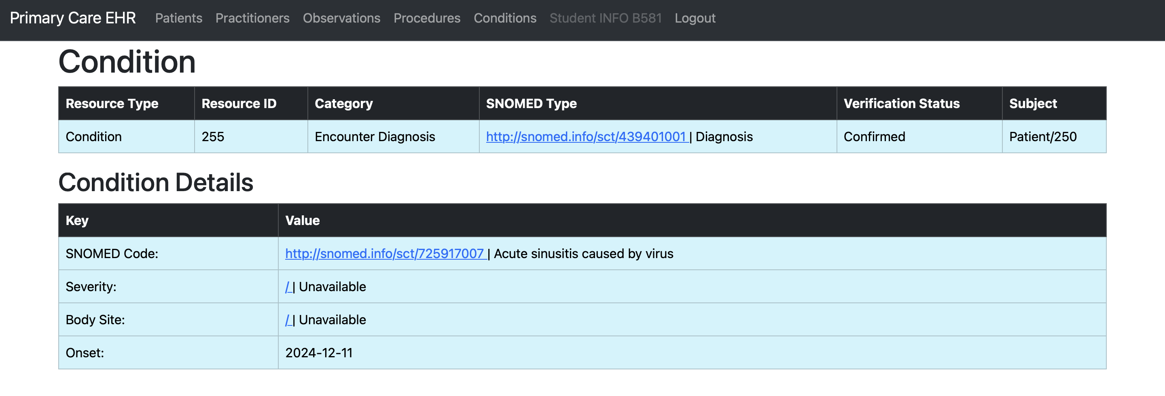
Condition Resource in Target API Server Linked with Patient

Slide 24
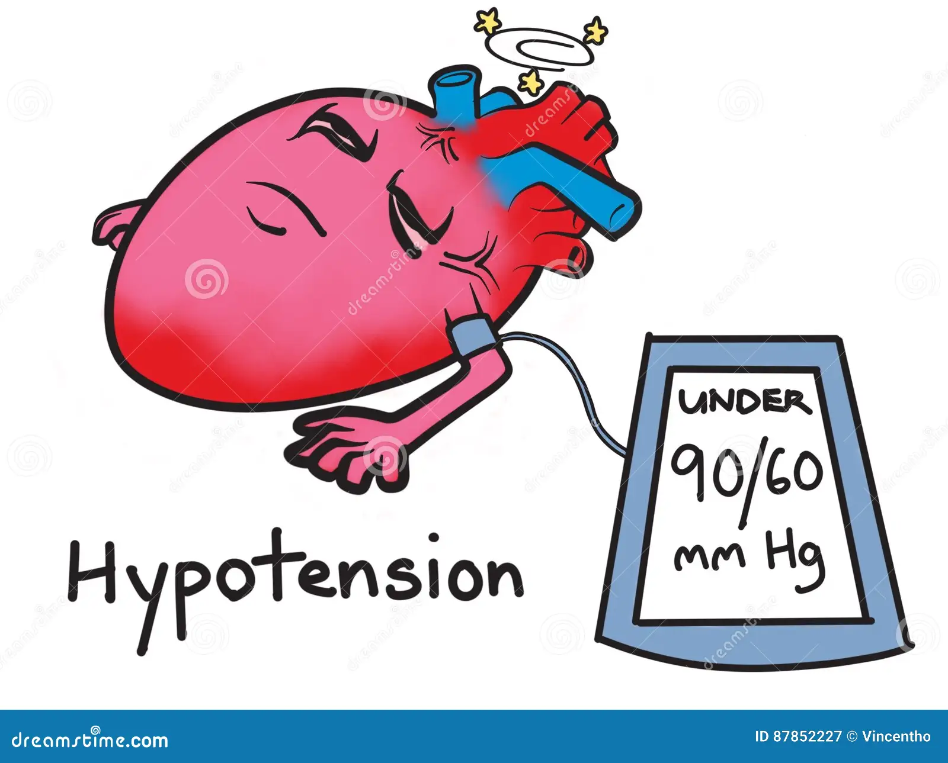
CODING TASK 3

Slide 25
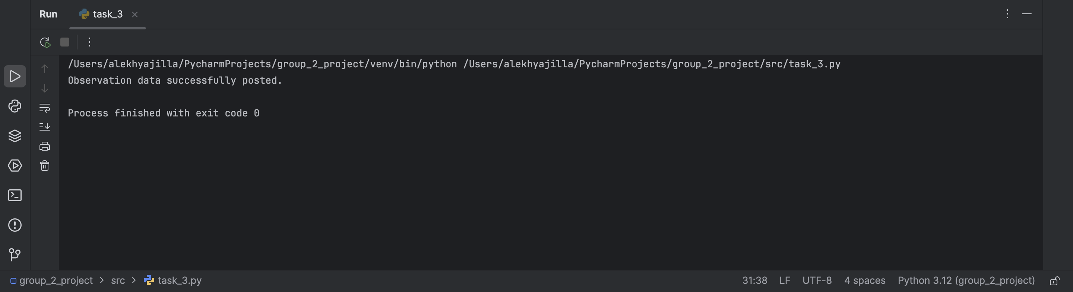
LIVE DEMONSTRATION OF THE CODE FOR THIS OUTPUT

Slide 26
Coding Task 3: Extract
Patient Resource: The patient ID created in Coding Task 1 was retrieved from response_ids.txt.
Observation Template: A JSON template for creating a Blood Pressure Observation resource was prepared using the target FHIR specifications obtained from Postman.

Slide 27
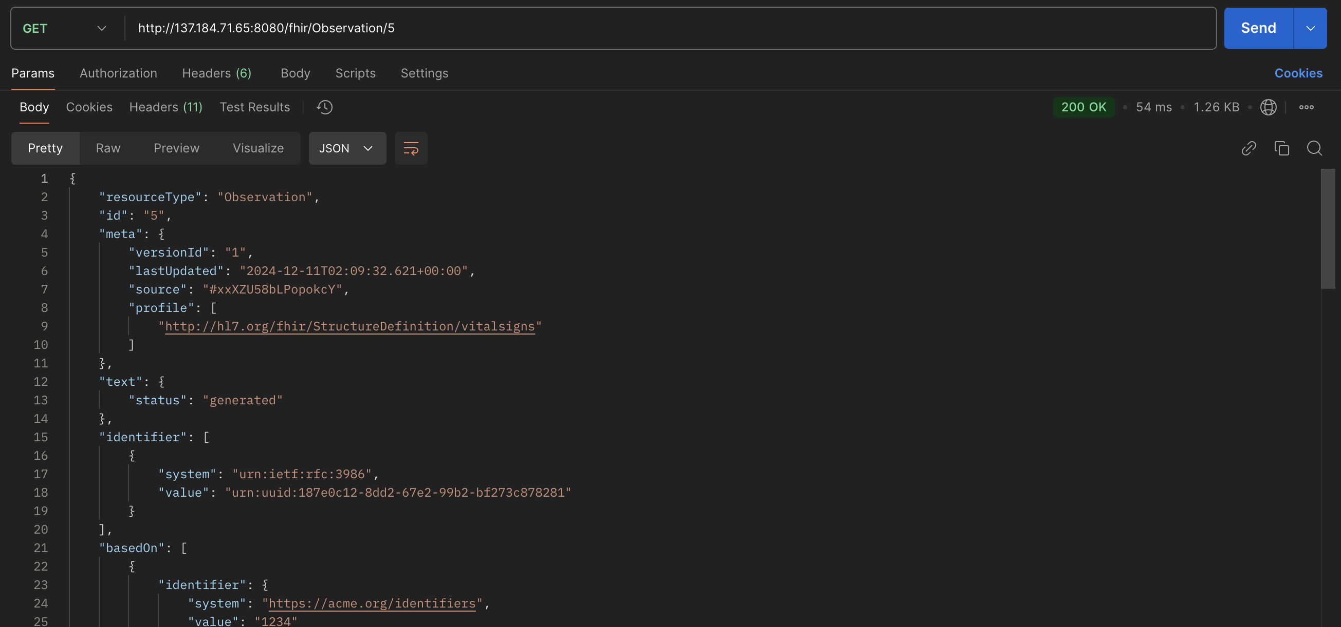
Observation JSON Structure from Postman

Slide 28
Coding Task 3 : Transform
Observation Resource:
The systolic and diastolic values were populated based on the standard regulations.
The patient ID was linked to the Observation resource, ensuring accurate data association.

Slide 29
Coding Task 3 : Load
Observation Resource Creation:
The transformed Observation JSON was posted to the Primary Care EHR server.
The association with the patient ID ensured the observation data was correctly integrated into the patient's medical record.

Slide 30

CODING TASK 4

Slide 31
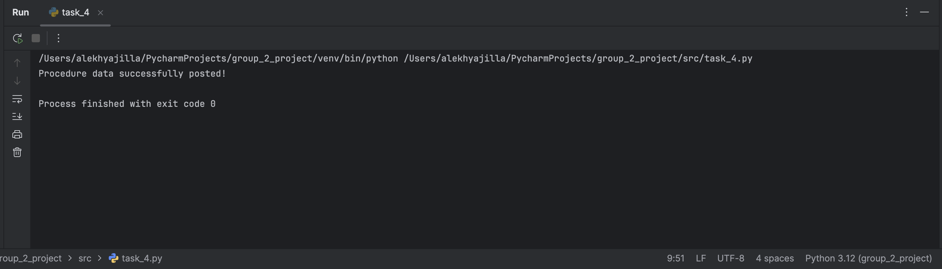
LIVE DEMONSTRATION OF THE CODE FOR THIS OUTPUT

Slide 32
Coding Task 4: Extract
Patient Resource: The patient ID created in Coding Task 1 was retrieved from response_ids.txt.
Procedure Template: A JSON template for creating a Procedure resource was prepared based on FHIR specifications, ensuring alignment with the Primary Care EHR server requirements.

Slide 33
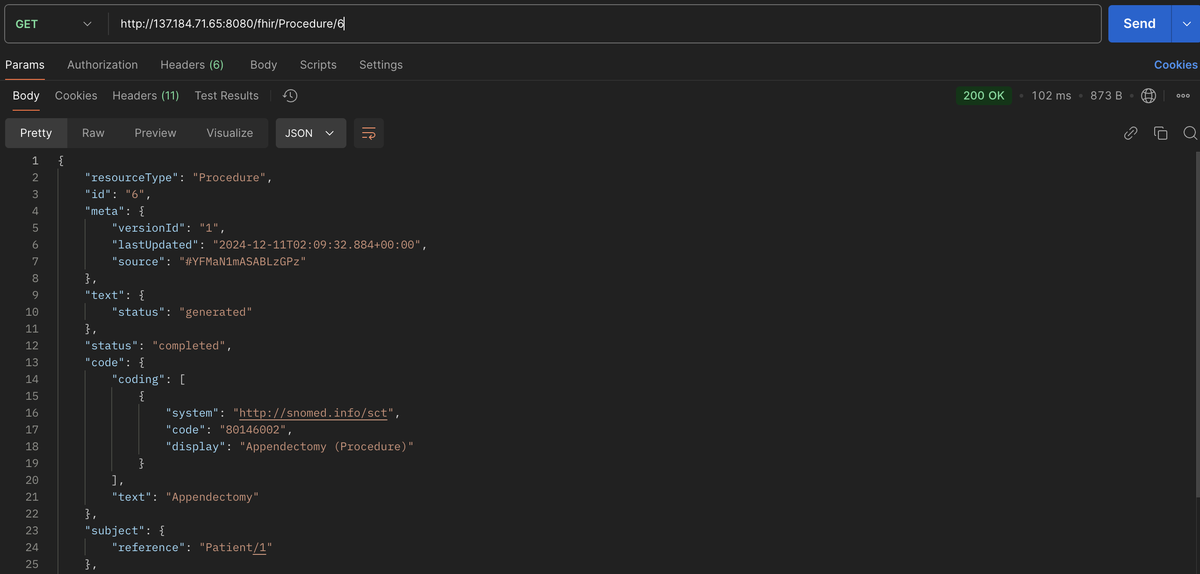
Procedure JSON Structure from Postman

Slide 34
Coding Task 4 : Transform
Relevant fields, including procedure type, performed date, and outcome status were populated.
Standardized SNOMED codes and references were integrated into the resource to maintain terminology compliance.
The patient ID was linked to the Procedure resource, ensuring correct data association.

Slide 35
Coding Task 4 : Load
The transformed Procedure JSON was posted to the Primary Care EHR server.
The resource was successfully linked to the patient ID, ensuring the procedure was correctly associated with the patient’s medical history.

Slide 36
Insights and Visualizations
Insights and visualizations in healthcare data play a pivotal role in identifying patterns and outliers, enabling early detection of diseases, and supporting predictive analytics. These tools empower healthcare professionals to allocate resources efficiently, improve patient outcomes, and support evidence-based policy-making.
Visualizations are a useful tool to understand and analyze the trends of patient data in healthcare servers, and these visualizations can be very helpful in enhancing clinical decision-making.

Slide 37
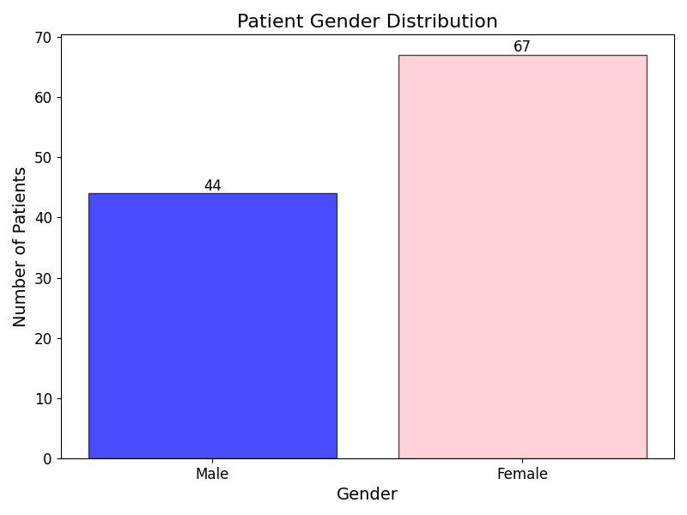
Barplot of gender distribution in OpenEMR
To understand the gender distribution in the OpenEMR server, a function was defined to count the occurrences of a particular gender. The obtained results are plotted as a barplot to gain insights.

Slide 38
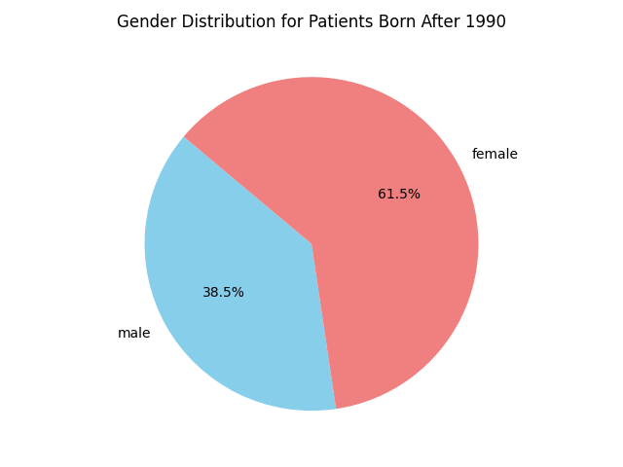
Piechart of Gender Distribution Born After 1990
To understand the gender distribution in the OpenEMR server that is born at a certain time, a function was defined to count the occurrences of a particular gender whose date of birth is greater than '1990-01-01’, and these results were plotted as a pie chart.

Slide 39
CHALLENGES AND LESSONS LEARNED

Slide 40
Challenges
FHIR Standard Complexity: Understanding and implementing FHIR resource structures and API interactions required extensive research and iterative testing.
Data Transformation Issues: Ensuring transformed data aligned with the target server’s requirements posed challenges, especially for complex resources like Condition and Patient.
Authentication and API Failures: Configuring OAuth 2.0 for secure server access and debugging failed API calls required significant effort and robust error handling.

Slide 41
Lessons Learned
Value of Standards: Adhering to FHIR and SNOMED standards ensures interoperability and enhances the reliability of healthcare data exchange.
Automation Enhances Efficiency: Automating tasks like ID generation and error logging streamlined processes and minimized errors.
Iterative Development Matters: Breaking the project into smaller tasks improved debugging, testing, and resource allocation, leading to better overall outcomes.

Slide 42

THANK YOU

Slide 43

Question And Answer Session

